Slide 1

Headlight Control System using LDR + Ultrasonic Sensor
Arduino for internet of Things (loT Projects)
Date: 26-11-2025
Team Members
1. Mouthika G (E0524003 )
2. Hariganesh V (E0524007)
Examiner 1:Dr.S.Narasimman
Examiner 2:Ms.Rhevathi

Slide 2
INTRODUCTION
Need for the technology
There is a growing need to automatically adjust vehicle headlights to prevent glare and ensure safe night driving. This technology provides a low-cost, real-time solution that adapts brightness based on ambient light and approaching objects.
Applications
Can be applied in low-cost intelligent transportation projects.
Useful in smart lighting and safety systems.
Helpful for bicycles and motorcycles to prevent glare.
Used in vehicles for automatic headlight brightness control.
Challenges to be addressed
Detecting accurate light levels under rapidly changing conditions.
Measuring distance reliably despite sensor noise or obstacles.
Avoiding false triggering due to reflections or ambient light variations.
Ensuring smooth and stable LED brightness changes without flicker.

Slide 3
INTRODUCTION
Motivation behind the study
The motivation behind this study is to reduce night-time accidents caused by improper or overly bright headlights. Many drivers fail to switch between high and low beams at the right time, leading to glare and unsafe driving conditions. By developing an automatic headlight control system, the aim is to improve safety for both the driver and oncoming vehicles. This project also seeks to provide a low-cost, smart lighting solution that can be applied to small vehicles such as motorcycles and bicycles. Additionally, the system helps conserve battery power by adjusting brightness only when required. It also supports the growing need for intelligent and automated vehicle safety technologies in modern transportation.

Slide 4
PROBLEM STATEMENT
The improper use of high-beam headlights often causes glare and reduces visibility for oncoming drivers, leading to unsafe night-time driving conditions. Small vehicles and bikes typically lack automatic systems to manage high-beam intensity, resulting in manual misuse. To address this issue, a low-cost, sensor-based solution is needed that can detect ambient light and approaching traffic and automatically adjust high-beam brightness to improve overall road safety.
Core Method / Algorithm / Technology Used
Two LDR sensors continuously monitor ambient illumination to distinguish between bright and dark conditions.
An HC-SR04 ultrasonic sensor precisely determines the proximity of approaching objects or vehicles.
Sensor data is interpreted through a classification logic that identifies light intensity and distance levels.
A rule-based decision algorithm governs whether each headlight operates at FULL or DULL intensity.
PWM (Pulse Width Modulation) ensures smooth and stable adjustment of LED brightness.
The Arduino Uno functions as the central controller, integrating sensor inputs and executing real-time intensity regulation

Slide 5
OBJECTIVES
To develop an automatic headlight control system that adjusts brightness based on ambient light conditions.
To use LDR sensors for accurately detecting bright and dark surroundings.
To integrate an ultrasonic sensor for measuring the distance of approaching objects or vehicles.
To design a decision-making algorithm that combines both light and distance inputs to control LED intensity.
To prevent glare for oncoming vehicles by dimming headlights when an object is too close.
To improve night-time driving safety using a low-cost, efficient, and real-time control system.

Slide 6
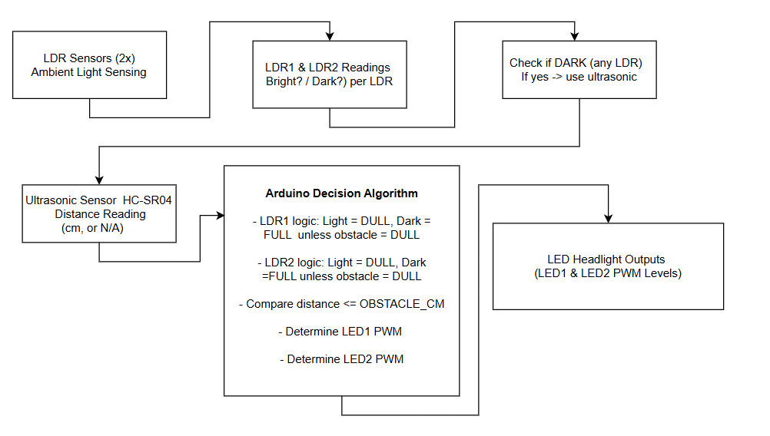
WORKFLOW DIAGRAM

Slide 7
MODULES
S.No | Modules | Methodology/ Algorithm | Technologies (H/W and S/W) | Implementation
1 | Sensor Input Acquisition | Read LDR1, LDR2 & ultrasonic values; convert to analog/digital readings | H/W: LDRs, HC-SR04, Arduino ADC pins S/W: AnalogRead(), pulseIn() | Collect ambient light & distance data continuously
2 | Light Condition Detection | Threshold-based classification (bright/dark) | H/W: LDR sensors S/W: ADC thresholds, filtering | Compare LDR values to threshold to detect brightness
3 | Distance & Obstacle Detection | Time-of-flight calculation to determine object proximity | H/W: HC-SR04 S/W: pulseIn(), distance formula | Detect if object ≤ 70 cm to reduce glare
4 | Decision Algorithm | Rule-based logic combining light + distance | H/W: Arduino Uno S/W: C/C++ Logic Conditions | Decide FULL or DULL brightness per LED
5 | LED Output Control | PWM modulation of LED intensity | H/W: LEDs, resistors S/W: analogWrite(), PWM | Adjust left & right LED brightness smoothly

Slide 8
RESULTS AND DISCUSSION
Results
The system accurately detected ambient light using two LDR sensors and clearly differentiated between bright and dark conditions. The ultrasonic sensor reliably measured distance and identified nearby obstacles within 70 cm. The LEDs responded appropriately shining at full brightness in dark areas and dimming automatically when bright light or a close object was detected. Each LED operated independently based on its respective sensor, and the PWM control ensured smooth, real-time brightness adjustments. Overall, the system performed consistently and delivered stable, intelligent headlight behavior.
Discussion
Integrating LDR and ultrasonic data proved effective for real-time headlight intensity control. Using two LDRs improved accuracy by sensing light from both sides, reducing false triggers. The rule-based algorithm delivered consistent performance with minimal processing needs, while PWM ensured smooth brightness transitions. Although minor calibration was required due to sensor variations, the system overall showed a low-cost and energy-efficient approach to automatic headlight adjustment for small vehicles.

Slide 9
CONCLUSION
The developed system successfully demonstrates an automatic headlight control mechanism that adjusts LED brightness based on ambient light levels and the distance of approaching objects. By integrating LDR sensors with an ultrasonic sensor and applying a simple rule-based algorithm, the system effectively reduces glare, enhances visibility, and improves overall road safety. The use of PWM enables smooth intensity transitions, making the lighting behavior similar to real automotive headlights. Overall, the project proves that a low-cost microcontroller-based solution can provide intelligent and reliable headlight control suitable for small vehicles and night-time commuting.

Slide 10
Thank you

